Slide 1
Crystal Cruises RESPONDERS DATA EXPLORATION
Notes:
This is an exploration-based analysis and most of the results are kind of incomplete. But I can show you some small findings in this data and hopefully give you some inspiration in future study.

Slide 2
Data & objective
THE SAMPLE was obtained by looking at all Crystal Society members who responded to the ads/mail from Crystal Cruisers mostly between 1997 and 2017 (1 obs in 1900, 3 obs in 1993-1995), where n = 123,583.
What can be our response of interest? (Multiple Y’s)
Total revenue
15-16 revenue
Added date
Last purchase date
What do we have as predictors? (X’s)
KBM
MindBase –Already successful!
MotiveMix
Living Well
Notes:
Since it’s the responders’ data and we notice they have all made some purchases so we cannot make prediction on whether they will be our customers as they already are. But in this dataset, we have the total revenue and 15-16 revenue for each customer, as well as the added date, last purchase date. These are the information that closely related to their purchase behavior and what we can do with this data is to find the characteristics of good customers and how their buying behaviors are affected by the predictors we have, including KBM, MindBase and MotiveMix. This is the main objective of this exploration.

Slide 3
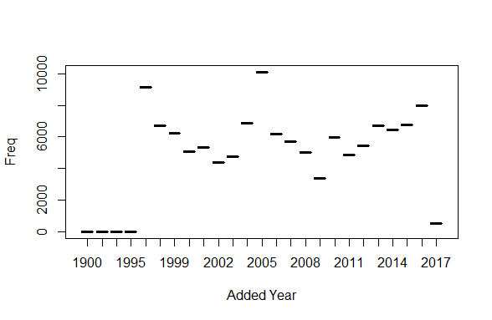
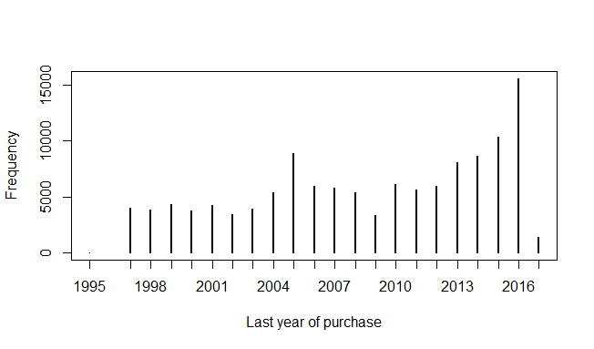
quick overview of some facts
Geographic pattern – region factor should be considered in the model (if we would like to predict who will be our potential customer).
#CA--30%
#FL--20%
Added year & Last purchase year
Time series, strongly correlated with financial environment. Eg. Financial Crisis around year 2008.
Notes:
Before we look into the associations, let’s quickly take a look at some interesting fact of some particular data that our clients offer us.
There is an obvious geographic pattern in responders with 30% customers from CA and 20% from FL. This may indicate that, region factor should be considered in the model (if we would like to predict who will be our potential customer). This can be a dominant predictor.
The distribution of added year and last purchase year appear to have a really nice time series, closely correlated with financial environment. Eg. Financial Crisis around year 2008.

Slide 4
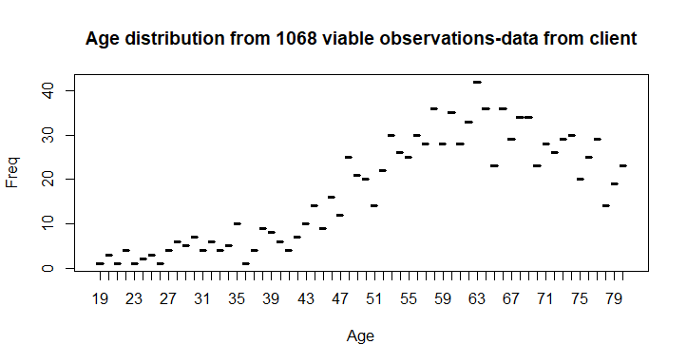
quick overview of some facts - Age
Age distribution
increasing trend:41-64 ; (slightly) decreasing trend:65-80
The accuracy of KBM estimated age :
Age1:0.1232877
Age2:0.4657534
Age3:0.5538462
Age4:0.6448598
Age5: 0.7226027
Age6: 0.9
Notes:
The age pattern, as we always assume age an important factor, looks like this. We can observe an increasing trend btw 41-64 and a decreasing trend btw 65-80. Notice that this plot is drawn from our clients’ true data and there are only 1068 viable ages. This being said, we can already see a clear trend from this data, as well as testing the accuracy of KBM estimated age. This may be not necessary for the analysis we present to clients but it’s interesting to know that, ,our estimated accuracy increase as the age increases.

Slide 5
Response (y)-based Segmentation
What can be our response of interest? (Multiple Y’s)
Total revenue
15-16 revenue
Added date
Last purchase date
Don’t have frequency, but can roughly obtain an alternative metric:
Interval= Last purchase date-Added date
Interval=0 : only purchase once!
Monetary
Recency
Frequency
(but not exactly, more like days in row)
Notes:
Let’s turn back to our responses. Notice that we have several dimensions here, which means we can understand the customer’s purchase behavior from different aspects. A popular way to evaluate it is the RFM analysis. R means recency, usually measured by the day since last purchase. We have that measurement in our dataset. M means Monetary, here we will directly use the total revenue as the measurement. F means Frequency, usually measured by how many times the customer purchase the product. We don’t have frequency, but can roughly obtain an alternative metric: Interval.
If the interval equals to one, we can conclude that the customer is an one-time or first time customer.

Slide 6
Response (y)-based Segmentation
Interval=0 : only purchase once!
If this dataset contains all the customer’s purchase information…
Before 2015 (customer added date <2015) , 61.4% of the customers only shop once – cumulative proportion.
Use ‘before 2015’ because new customers may not ‘have the opportunity’ to shop twice.
From 2015-2017 (customer added date >=2015), 90.8% of the customers only shop once. We may assume around 30% of them will become our “return customers” based on historical proportion but not for sure.
In these two years, 10.2% of our customers are return customers.
Would it be interesting to look at this proportion every year/every 2 years?
Notes:
Actually this group accounts for a large percentage of the total customers.

Slide 7
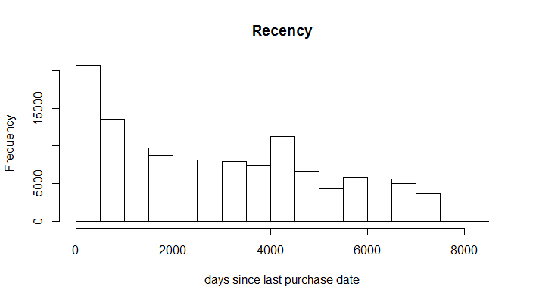
recency
#days since last purchase
#0% 25% 50% 75% 100%
#0 897 2619 4532 8059 (Unit: days since last purchase)
Notes:
How does it looks like in this data? First we check the recency distribution, it’s skewed and the median is approximately 7 years.

Slide 8
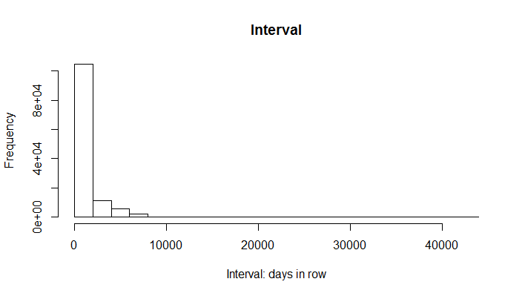
Interval (instead of frequency)
#Time differences in days
0% 25% 50% 75% 100%
0 0 0 794 42708
Traditional quantiles not appropriate in this case, turn to this one:
Time differences in days
0% 65.06% 76.7% 88.35% 99.99%
0.000 1.000 986.000 2687.000 7298.642
Notes:
And interval, which is extremely skewed with 65% of them having interval=1. So instead of the traditional quantile, we set all these zero-interval customers to a single group and then separate the rest of returning customers with equal space.

Slide 9
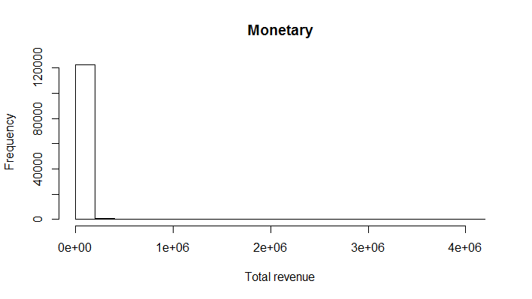
Monetary: total revenue
0% 25% 50% 75% 100%
1.00 5203.80 9158.91 18327.77 4142974.27
Notes:
Monetary, amazingly skewed, but we’ll still use traditional quantiles as there are no ‘zero-monetary’ customers.

Slide 10
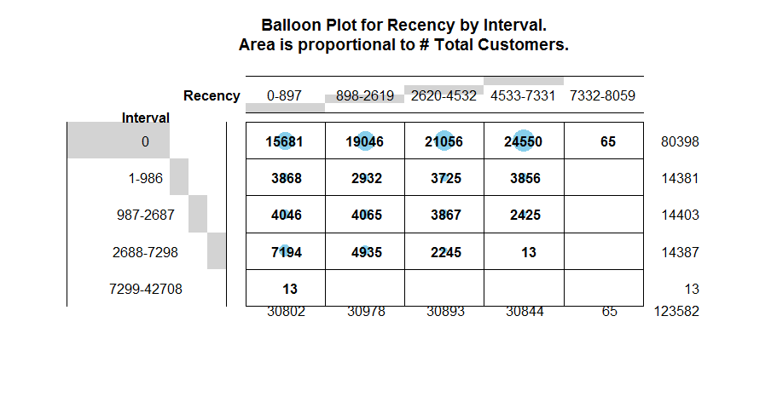
Recency X interval
Notes:
Now we can look at the interaction between Recency and interval.

Slide 11
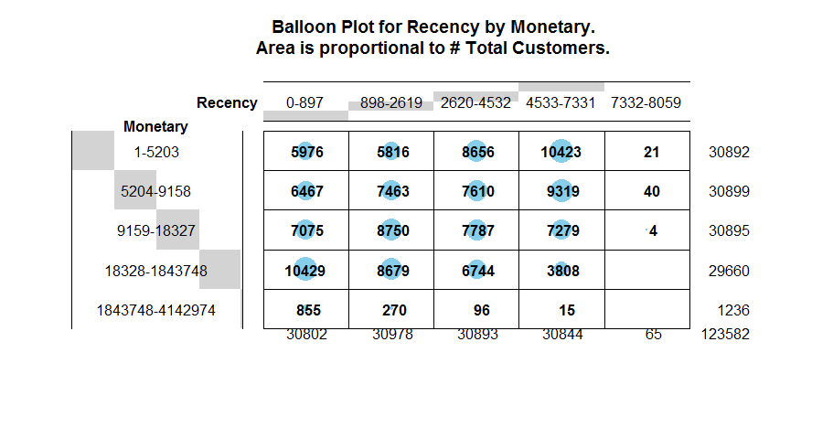
Recency X monetary
Notes:
Also Recency by Monetary

Slide 12
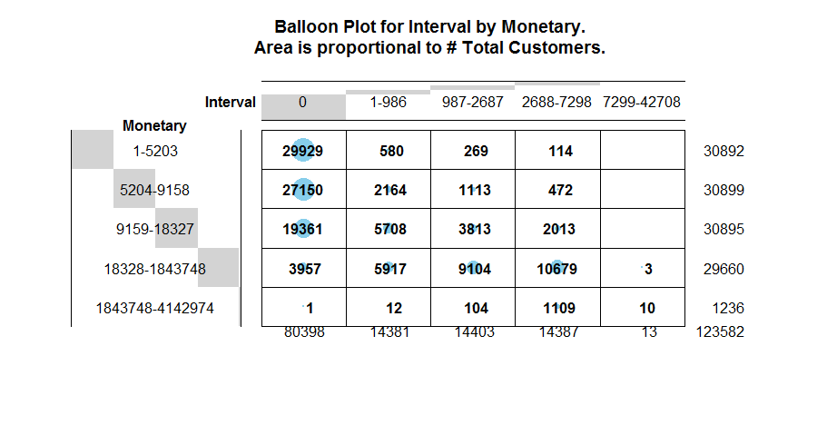
Interval x monetary
Notes:
As well as Interval by Monetary.

Slide 13
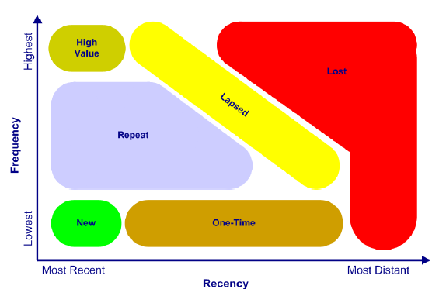
INTEPRETATION
Notes:
And they do have interpretations. A classic segmentation was like this. With specific

Slide 14
Possible interpretation
Notes:
But we have a little different interpretation here. We can mainly look at the first 4 rows and columns here since the last column is really extreme.

Slide 15
What do we have as predictors? (X’s)
KBM
MindBase –Already successful!
MotiveMix
Living Well
But we may view it
a little differently
Notes:
Let’s look back to the dimensions we have. In the past 10 years, MindBase has been proved to be successful. What I will suggest to add based on the responders data is a new measurement:

Slide 16
mindbase x contribution to revenue
MindBase –Already successful!
A new measurement: Contribution of Total revenue and 15-16 Revenue
 | 09-'17 Total Ocean Cruisers (Responders) | Total | 1 Expressive | 2 Driven | 3 At Capacity | 4 Rock Steady | 5 Down to Earth | 6 Sophisticated | 7 Measure Twice | 8 Devoted
 |  | 11697 | 546 | 513 | 154 | 1100 | 610 | 2947 | 4603 | 1224
 |  | 100% | 5% | 4% | 1% | 9% | 5% | 25% | 39% | 10%
Revenue 15-16 Contribution |  | 100% | 4% | 4% | 1% | 10% | 4% | 23% | 42% | 11%
Revenue 15-16 | H - revenue>$10821 | 100% | 2% | 2% | 0% | 4% | 2% | 9% | 18% | 5%
 | L - revenue<$10821 | 100% | 3% | 3% | 1% | 5% | 3% | 16% | 21% | 6%
 | New 15/16 cruiser, Any Cruise | Total | 1 Expressive | 2 Driven | 3 At Capacity | 4 Rock Steady | 5 Down to Earth | 6 Sophisticated | 7 Measure Twice | 8 Devoted
 |  | 4569 | 198 | 197 | 67 | 512 | 284 | 1342 | 1576 | 393
 |  | 100% | 4% | 4% | 1% | 11% | 6% | 29% | 34% | 9%
Revenue 15-16 Contribution |  | 100% | 4% | 4% | 1% | 12% | 6% | 28% | 36% | 8%
Revenue 15-16 | H - revenue>$10821 | 100% | 2% | 1% | 1% | 6% | 3% | 12% | 17% | 4%
 | L - revenue<$10821 | 100% | 2% | 2% | 1% | 6% | 3% | 17% | 18% | 5%
Notes:
Contribution of total revenue or 15-16 revenue. This is the crosstable of mindbase by contribution of revenue. Similar to the work we’ve done before and with similar results : Measure Twice group still accounts for the largest proportion but there is a decreasing trend of this group as sophiscated, down to earth and rock steady make more contribution these years.

Slide 17
Motivemix x revenue
What do we have as predictors? (X’s)
KBM
MindBase –Already successful!
MotiveMix → how MotiveMix affects revenue?
Living Well

Slide 18
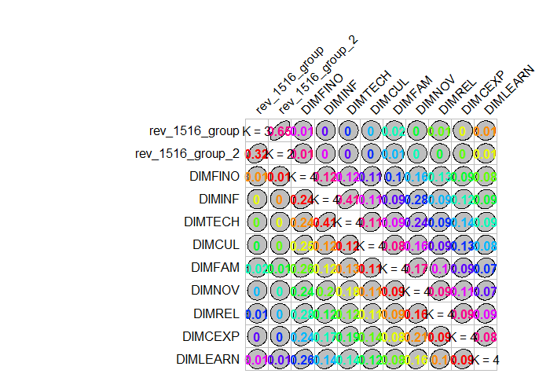
A REALLY NEW WAY TO DO EXPLORATION
MotiveMix → how MotiveMix affects revenue?
Goodman and Kruskal’s tau
Measuring association between
categorical variables
The tau measure is based on the fraction of variability in the categorical variable y that can be explained by the categorical variable x. In particular, the fraction of variability in x that is explainable by variations in y may be very different from the variability in y that is explainable by variations in x, as examples presented here demonstrate.
https://cran.r-project.org/web/packages/GoodmanKruskal/vignettes/GoodmanKruskal.html

Slide 19
Prediction aspect: are they significant variables?
MotiveMix → how MotiveMix affects revenue?
Logistic Regression
Call:
glm(formula = rev_1516_group_2 ~ DIMFINO + DIMINF + DIMTECH +
DIMCUL + DIMFAM + DIMNOV + DIMREL + DIMCEXP + DIMLEARN, family = binomial(link = "logit"),
data = ltrain)
DIMFAMH -0.24278 0.08086 -3.003 0.00268 **
DIMFAML 0.34590 0.11612 2.979 0.00289 **
…….
DIMLEARNH -0.43088 0.08978 -4.799 1.59e-06 ***
Signif. codes: 0 ‘***’ 0.001 ‘**’ 0.01 ‘*’ 0.05 ‘.’ 0.1 ‘ ’ 1
(Dispersion parameter for binomial family taken to be 1)
Null deviance: 4581.8 on 3319 degrees of freedom
Residual deviance: 4477.1 on 3300 degrees of freedom
AIC: 4517.1
Higher family orientation Higher continuous learning
→higher revenue
Notes:
A baseline model

Slide 20
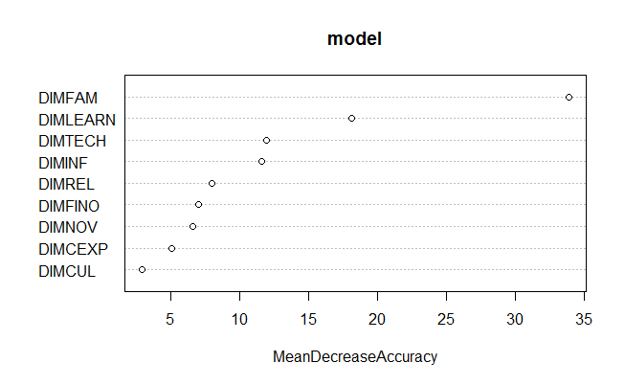
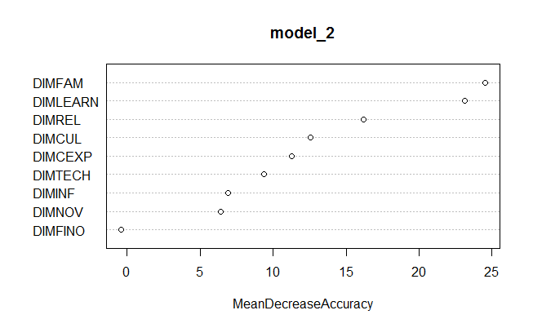
Prediction aspect: are they significant variables?
Random Forest: variable importance plots—
Yes, FAM &LEARN are two most important variables in predicting revenue!
Notes:
For variable selection, we use a measurement in random forest algorithm as a reference for variable importance comparison. (This measurement is called mean decrease in accuracy. Simply speaking, the mean decrease in accuracy is how much the model fit decreases when you drop a variable. The greater the drop the more significant the variable.)

Slide 21
Why financial optimism not important?
DIMFINO can be extremely predictable if the response is ‘whether he/she WILL be our customer’.
But it is really skewed in existing customers so it has a bad performance of predicting ‘if he/she is our GOOD customer/ how much he/she will spend on our product’

Slide 22
summary
What can be our response of interest? (Multiple Y’s)
Total revenue
15-16 revenue
Added date
Last purchase date
What do we have as predictors? (X’s)
KBM
MindBase –Already successful!
MotiveMix
Living Well
RFM(RIM): A CLOSER LOOK AT THE BUYING BEHAVIOR
Just add a new measurement
2 Predictive variables

Slide 23
Thank you!

